Slide 1
课程简介及概述
交通大数据分析
2021年春季
马晓磊
Notes:
Today I will just do an overview of this course.

Slide 2
教学团队
教师:
马晓磊，教授，交通科学与工程学院
办公室：沙河校区B座807-4
电子邮箱：xiaolei@buaa.edu.cn
工作时间：预约
授课时间：每周三上午10:40 - 12:15，J3-308
研究领域：公共交通，交通数据挖掘

Slide 3
本节大纲
为什么开设这门课程？
本课程包括哪些内容？
本课程是如何组织的？
Notes:
This is an outline of my lecture today
Today I think we will just go over the basics of this class.
It is my sincere hope that the tools I will introduce in this class will make your life easier.
I want this class to enable you to utilize database management systems in your research, course work, and future employment to achieve greater power and efficiency.
Because of this, we will mostly stick to the basics to give you a firm foundation on which to build more advanced knowledge.
If you have more advanced interests and questions, I can definitely help you out.

Slide 4
为什么开设这门课程？

Slide 5
让我们来谈谈交通本身…
学界和业界
交通学科的理论基础？
理论与实践
交通组织与交通规划
TRB vs. TRB
专业培养与就业
设计院 vs.互联网公司
https://www.zhihu.com/question/28573109
Notes:
一部分是搞理论的（学物理出身的人居多，之后也有相当一部分土木工程的教授加盟），另一部分的是搞应用的（以Highway Research Board）。双方的研究可谓各有特色，前者提出理论模型，后者则依赖于实际数据和统计模型。
缺乏科学依据和严谨的科学精神。而搞实践的人则继承了经验主义的理念，坚信实际数据才是最可靠的；同时也认为那些复杂的数学模型在实际中很难应用，一些假设不符合实际情况，很难在实际中运用。当然实践证明，这些理论派看起来比较“没有技术含量”的东西，在工业界中确实更有市场，甚至能生成出比那些“科学”的模型更准确的结果。

Slide 6
交通工作者的挑战
截至2003年：
未来10年，超过50%的州运输局员工将会退休。
与此同时，有资格从事交通工作的人数逐年减少。
数据管理和分析是运输员工最需要的技能之一。
Notes:
From a broader perspective…
This article, titled “The Transportation Workforce Challenge”, was published by the Transportation Research Board in 2003.
They have been saying for 10 years that more than 50% of the transportation workforce will be retired in 10 years.
For the new generation of workforce, data management and analysis skills are in great need
I think it is really interesting because, even though the article is 10 years old now, those skills identified as important for transportation professionals have only become more important in the time since.

Slide 7
让我们来谈谈交通本身…
理论：
交通流理论
DTA（动态交通分配）
四阶段模型
跟驰模型…
研究差距
实践：
深度学习
强化学习
城市计算
数据挖掘…
Notes:
交通工程既需要数学理论，又需要数据支持，需要把两者结合。

Slide 8

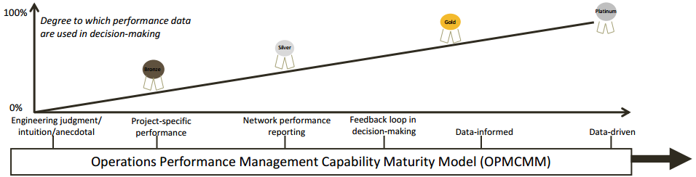
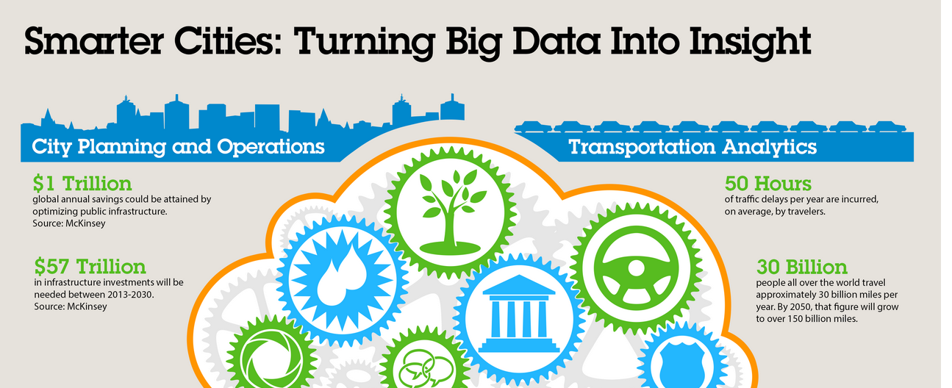
现在…
MAP-21：数据驱动的性能报告¹
交通中的大数据分析²
面向商业和研究的
智慧城市倡议³
8
MAP-21 and Operations Performance Management. Rich Taylor, FHWA Office of Operations. From Presentation at NATMEC 2014, Chicago IL.
Big Data Analytics: Driving Value Beyond the Hype - Roundtable Summary. (2012). Volpe & The U.S. Department of Transportation Research and Innovation Technology Administration.
IBM Smarter Cities Initiative
Notes:
If we look at the pictures for now..
We can see that the people that wrote the 2003 article were kind of right.
As basic data management and analysis skills are assumed to be only a starting point for data literacy.
The previous generation of federal transportation funding (MAP 21) places great emphasis on
performance measurement and reporting
data collection and analysis.
Transportation is the focal point in the smart cities initiatives, which hope to make our cities smarter and more efficient using big data analytics.
This is not me looking into the future and speculating, this is what is current in transportation.

Slide 9
拥堵是全国性的问题
拥堵不仅仅是大城市的问题：
在2000年至2011年之间，小城市高峰时段的交通拥堵从车辆行驶里程（VMT）总量的21％增长到27％
高峰时段出行占比是46%，在西雅图是64% ¹
西雅图地区交通拥堵导致的燃料使用量：超过4700万加仑/年¹
43亿小时的时间被浪费
间接影响：
空气污染，出行费用，等
Texas A&M 2012 Annual Urban Mobility Report
Notes:
Current transportation system has problems
Look at the statistics:
Congestion in small urban areas has increased over the last decade.
In Seattle 64% of peak period travel is congested.
Cause a lot of economic and social impact (fuel consumption, time lost, air pollution, etc.)
Personal experience…
As a transportation student, when I talked to people not in the this field, their first question will usually be
How to solve traffic congestions in Seattle.
How would you answer this question?
The three countermeasures against congestion:
Increase supply (SR 99 tunnel to replace Alaskan Way Viaduct, New 520 bridge)
Manage demand (larger scale urban-planning)
Increase capacity of existing infrastructure using ITS

Slide 10
数据对于现代交通至关重要
现代交通需要智能交通系统 (ITS)
ITS 需要智能 →智能需要信息 → 信息需要数据
智慧城市和智慧工具：
无处不在的感知
数据分析
开放数据共享
数据驱动的决策
数据获取、管理和解释需要交通和信息技术领域技术的结合。
Notes:
Why modern transportation requires ITS?
Seattle, like many cities, is space constrained. Any new roadway infrastructure requires either destroying something that is already there or finding very expensive alternatives such as tunneling.
ITS is the often the best solution, but this will come down to that we need lots and lots of data.
The smart cities and smart transportation systems means:
This do require combination of knowledge from Transportation and information technology.

Slide 11
为什么选择 ITS？
Notes:
The red line indicates the trend of registered vehicles; blue line indicates the trend of newly built road infrastructure; green line indicates the trend of vehicle miles traveled (VMT).
VMT and number of registered vehicles are increasing sharply, but the road construction speed increases very slowly. This implies a huge gap between travel demand and supply.

Slide 12
那么，有哪些选择呢？
减少需求
减少出行需求
提供多种出行方
增加供给
建造更多的交通设施
提高系统效率
使用 ITS 提高现有基础设施的通行能力
Notes:
So, how can we solve the issue of demand-supply imbalance? There are typically two ways: decrease demand, and increase supply.
To decrease demand, we can reduce people’s travel desire such as congestion tolling or provide alternative means such as public transit.
To increase supply, we can construct more roads or use ITS to increase system efficiency.

Slide 13
减少需求
减少旅行的需求/欲望（负担能力？）
价格
居家办公
提供多个选项
自行车
步行
公共交通

Slide 14
增加供给
建造新的交通设施Construction of new facilities
城市的拥堵最严重
建造成本高昂
诱导的需求将抵消一些效果
Project | Total Cost | Lane-Miles | Cost per Lane-Mile
Route 3, North Boston | $395.0 million | 42 | $9.4 million
I-4 Tampa to Orlando | $403.0 million | 73 | $5.5 million
I-5 Oregon | $30.0 million | 5.16 | $5.8 million
US 26 Sunset Hwy. Oregon | $10.6 million | 2.24 | $4.8 million
US 12 near Walla Walla River | $36.4 million | 25 | $1.5 million
US 101 on Olympic Peninsula | $1.8 million | 0.8 | $2.2 million
Notes:
Building new roads are not practical due to:
(1) Very costly to construct and maintain
(2) Increased supply will be diluted by more demands. For example, if we build more lanes on a freeway, people who did not drive will be attracted to drive, and the road will become congested very soon. Therefore, it is not cost efficient to construct more facilities.

Slide 15
ITS的作用
通过技术提高系统效率
减少人为失误
自动驾驶汽车
优化系统效率
事故响应
匝道控制
告知用户
拥堵流地图
行程时间估计
Notes:
The only solution is to increase system efficiency with technology. For example, we can use autonomous vehicles to increase road capacity by reducing vehicle headways. We can also use incident management technology to fast process vehicle accidents and divert traffic from freeway to arterial. With the mobile apps, we can provide more rich traffic information such as google maps to estimate arrival times.

Slide 16
总体效果
减少
需求
提供
多个选项
提高
通行能力
16
Notes:
With the above technologies, we expect the number of vehicles will be reduced by promoting public transit, VMT is reduced by tolling or telecommuting, and the efficiency of existing infrastructure will be greatly gained by ITS

Slide 17
ITS愿景
特殊事件
ITS
公路通行能力
天气
施工区
冲突
Notes:
As the result of introducing ITS technologies, the adverse effects of special events, weather, work zones and incidents will be mitigated, and thus increase highway capacity.

Slide 18
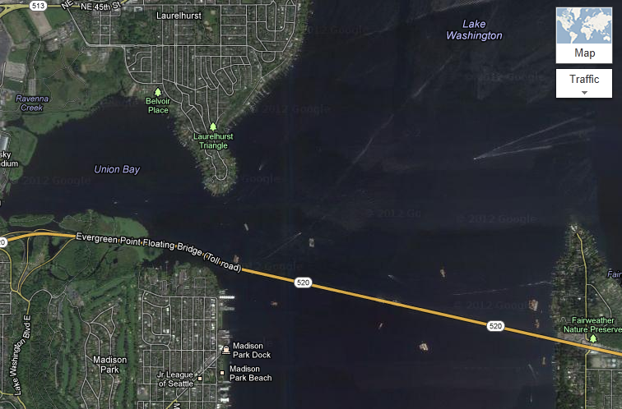
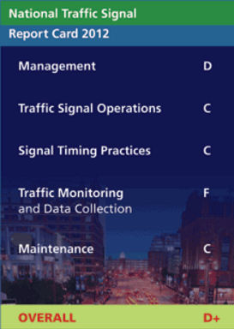
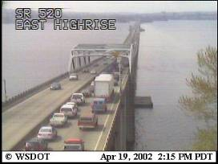

我们需要交通信息
Notes:
What can we do with the data (520 example):
Measure performance – performance report (daily/annual)
Dynamic tolling system to manage demand/optimize control strategies
What is the current status of our data work?
2012 National traffic signal report card (maybe read in Yinhai’s operations class?) gives the nation an F in Traffic Monitoring and data collection.
This grade is not due to hardware or software limitations, rather it is due to mishandling and a general lack of interest or capacity to maintain, quality check, and apply available data.
Note that this is already 10 years passed the workforce challenge article which emphasized the importance of data knowledge.
This is also where this class comes in.

Slide 19
交通数据的重要性
交通数据库
Notes:
Although this class will mostly focusing on data management and analysis of vehicular/ground transportation, here I do want to mention some examples of how transportation data can be used for different travel modes.
Maritime shipping. We need data to insure continued chain of possession for shipping containers, and analyze risk on freight flows. So that shipping companies can plan for charters and identify risks (i.e., points where a ship may end up running with little cargo).
Similar system is required for air transport. Manage flights/passengers at airports to avoid delay/cost. This is extremely important considering air transport is highly unpredictable because of its nature.
A typical transportation data application is the logistics and planning system used by UPS
UPS is currently working on a system that combines driver, 101,000 delivery vehicle fleet, and customer data into a mathematical model that will be used to craft optimal routes for drivers to take. The purpose of the system is to improve operating efficiency, but will also have the result of reducing fuel consumption and emissions. While the system will not be fully deployed until 2017, the current implementation is expected to save 1.5 million gallons of fuel by the end of this year. One early objective of the system is to find routes with minimal left turns, which typically involve more idling/wait time. This is a great example of big data analytics in transportation and logistics.
To get a rough idea about how complicated the routing problem can be. One single UPS driver will have an average of 120 daily deliveries. The number of all route combinations of a single drive can make a number far greater than the number of nanoseconds the earth has existed. (source: UPS Speeds ORION Deployment And Takes Routing Optimization To New Heights, Press Release Atlanta, October 30, 2013)

Slide 20
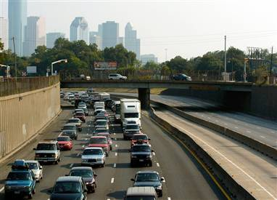
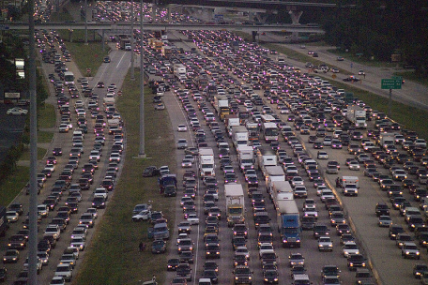
紧急疏散
丽塔飓风，2005年9月22日
Source: http://www.msnbc.msn.com/id/9444059/
Source: http://en.wikipedia.org/wiki/Hurricane_Rita
Notes:
Here is a great example of how transportation data can be applied.
When Hurricane Rita was headed to the Gulf coast, engineers were able to determine that there was no way the evacuation could be completed in time without drastic measures.
As a result, the governor of Texas (Rick Perry) and the State DOT implemented a contra lane reversal, in which all lanes on several interstates were used to serve vehicles leaving the city of Galveston. It was the biggest mass evacuation in US history.
Left Picture: Evacuees on Interstate 45 leaving Galveston on September 21.
On September 22, Governor Perry and the Texas Department of Transportation implemented a contraflow lane reversal on Interstate 45 north towards Dallas, on Interstate 10 west towards San Antonio, U.S. Highway 290 northwest to Austin.^{[12]}

Slide 21
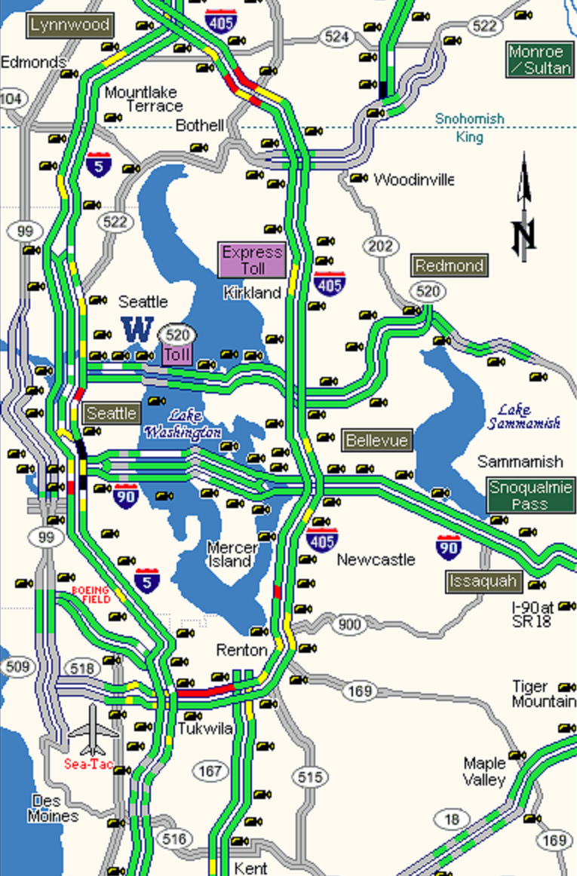
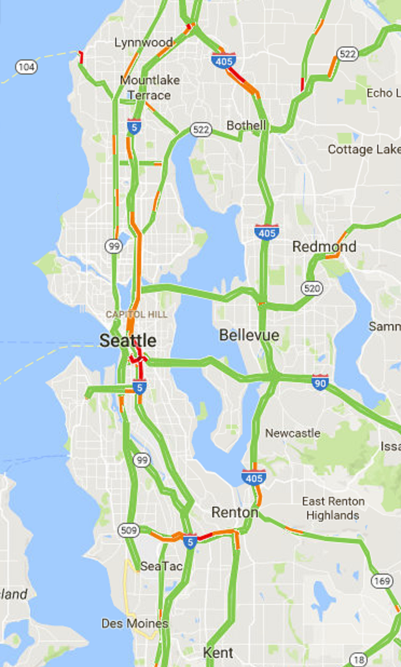
先进的出行者信息系统
ue
华盛顿交通局
交通地图http://www.wsdot.com/traffic/seattle/default.aspx
贝尔维尤交通摄像机http://www.cityofbellevue.org/trafficcam/
谷歌交通地图
Notes:
This is showing what we are doing with advanced traveler information systems (ATIS).
As an example, traffic map on WSDOT website is presented here.
Basically, we can know large-area traffic condition through the flow map, where different colors showing speed in different ranges.
Details of specific locations are available from video images from surveillance cameras.
Google traffic map is shown on the right. In general these two maps are very similar, showing traffic congestions in similar locations.
Any differences in these two maps? Consider data source.
Loop detectors vs. probe vehicle
The scope of the data that google has access to is really incredible, especially when you consider that they can actually perform analytics on it.
Not only can google tell you were to go and how long it will take, they can tell you about transit schedules, businesses, and road closures.

Slide 22

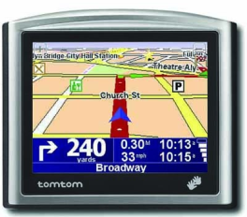
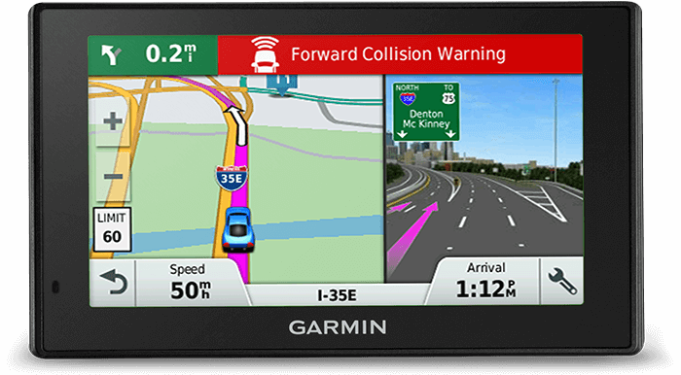
交通数据的重要性
Notes:
Navigation applications are probably most wide-used transportation applications.
Tom Tom Navigation System around $400 ten years ago.
More recent one less than half the price.
Or just use your smart phone (almost free with much more information).
Not only the technology is evolving, the cost is also decreasing.
When a new version of Google’s free map and navigation app became available for iPhones last December (2012), 10 million people downloaded it in just two days—almost as many as buy a Garmin GPS in a year.
Traditional navigator builders such as Garmin are switching to wearable devices.

Slide 23
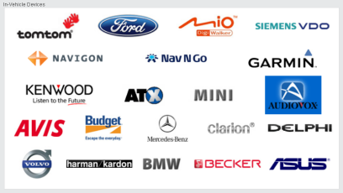


交通数据的重要性
Notes:
Here shows some groups from commercial companies to public agencies who are working on something related to transportation data.
What I want to mention here is that some communication companies/automobile companies are collecting location data from vehicles and commercial GPS devices to their analysis or sell data to government/institutions/whoever interested.
Some of the datasets are quite famous and I believe you will have chances to perform some analysis on these data someday eventually if you will be staying in this field.
INRIX was founded by former Microsoft employees in July 2004. HERE was previously owned by Nokia but recently sold to a group of German companies, Audi, BMW, Daimler.

Slide 24
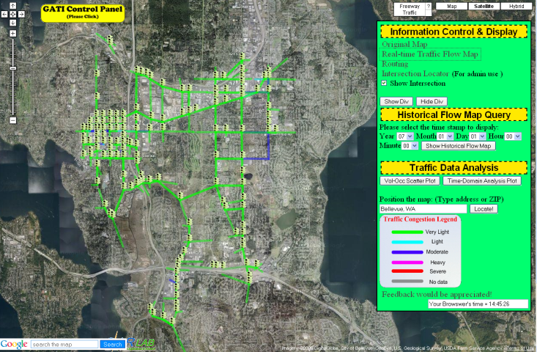
交通数据的重要性
STAR 实验室基于谷歌地图的主路交通性能系统
第一代
Notes:
A number of years ago, the STAR Lab began developing an online transportation data management, analysis, and visualization platform using google maps.
This is the first generation version.

Slide 25
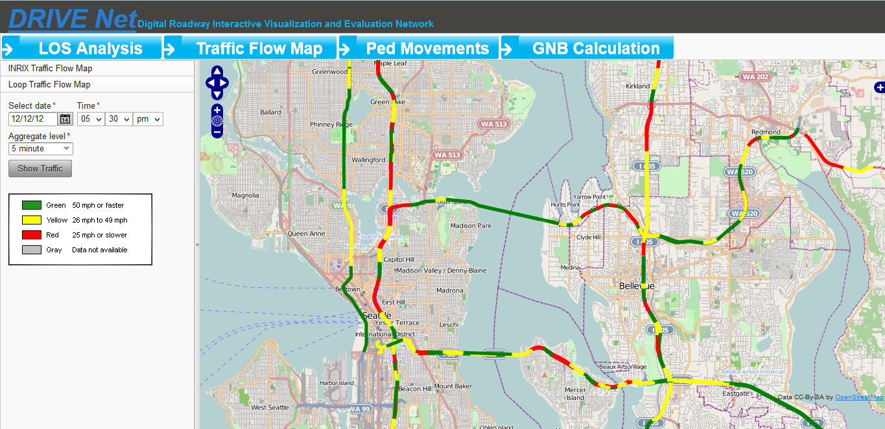
交通数据的重要性
Source: http://www.uwdrive.net/
Notes:
The current generation of platform called DRIVE Net
Right now this page can be used to do historical analysis of incidents and roadway performance.
In the future will be equipped for near real time upload of loop detector data.
DRIVE Net(I developed when I completed my PhD degree at University of Washington)
Digital Roadway Interactive Visual Evaluation Network
uses mostly open source tools including openstreet maps and postgre sql.
Combines many data sources, including INRIX, HERE, single loop, roadway GIS and geometric, emissions factors, mobile and static Bluetooth sensors, HCM factors, etc.
Archiving, quality control, speed, travel time, historical analysis, visualization, and dissemination of data.

Slide 26
交通数据的重要性
人工智能
交通平台
手机
处理
输入数据至合适的AI模型
可视化

Slide 27
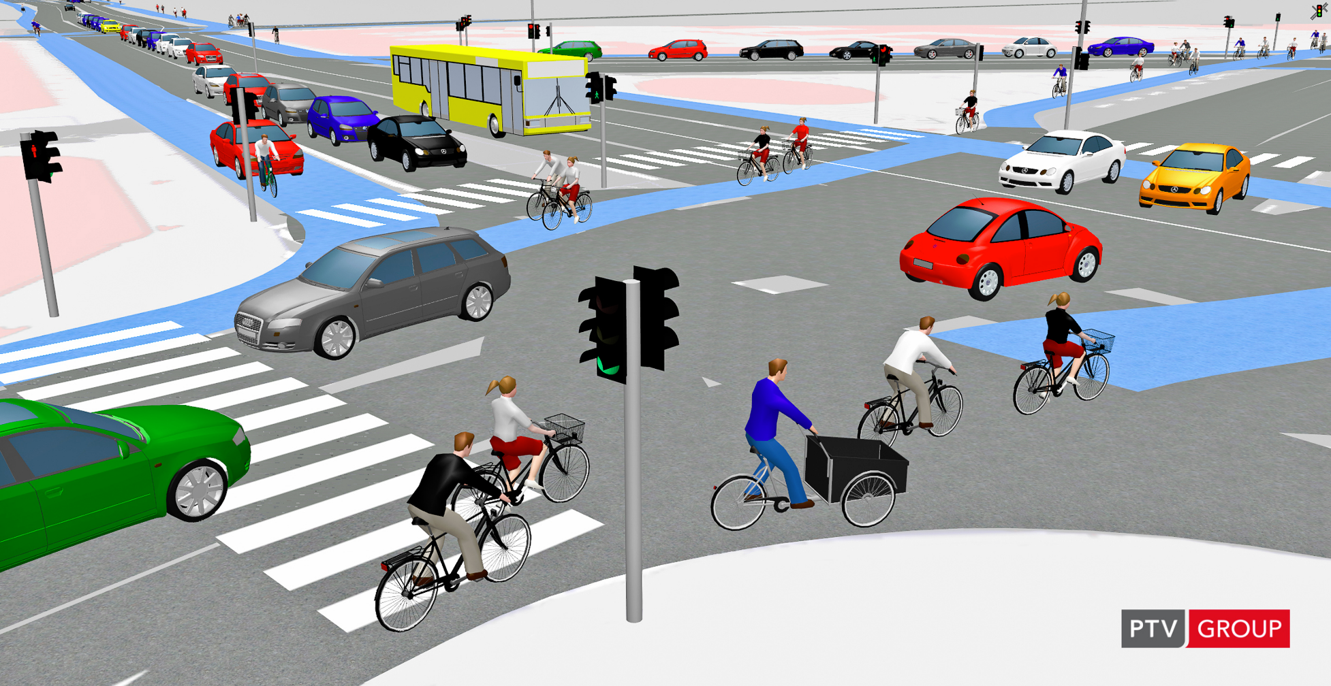
交通数据的重要性
Notes:
A great deal of transportation engineering work now relies on microsimulation models such as PTV’s VISSIM.
Simulation can provide us with a lot of data for analysis purposes.
One important thing to note is that simulation model has to be carefully calibrated before generating results.
Vehicle composition
Traffic flow
Driving behavior
Control plan
All these require collection of real data.

Slide 28
交通数据的重要性
上游检测站
下游检测站
行驶方向
车道阻塞
车道阻塞导致的车辆排队
V₂
累积交通量
V₁
V₃
时间
T_{d}
T_{r}
事故诱因的行程延误排队图
Notes:
One major task that simulation model can do is to measure delay and queue length, which is hard to collect on the real site.
590 ramp metering project, goal is to minimize delay.
Actually when you have collected loop data, if combined with traffic flow/queueing theory, you can also develop a method to calculate delay caused by incident.
There has always been a trend to prefer real data generated results rather than simulation results.

Slide 29
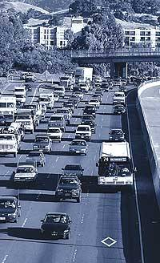
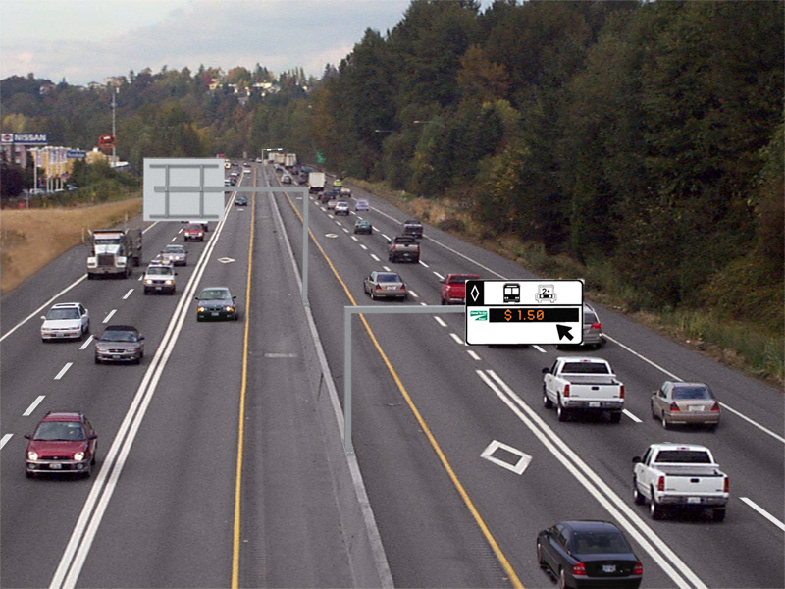
交通数据的重要性
Image sources: http://www.mtc.ca.gov/news/transactions/ta11-1204/vision.htm and WSDOT
Notes:
Anyone has recognized where these pictures are taken?
State Route 167, HOT lane
On SR 167, toll rates are updated every five minutes based on traffic conditions, as established by loop detectors.
Also, because this is a pilot project, performance monitoring is very important.
WSDOT has released annual performance reports for the project.
STAR Lab has been helping with the data processing.
The file that WSDOT is trying to give us is 100GB, and poorly organized.
Someone must process and manage that data and make it available for analysis online.

Slide 30
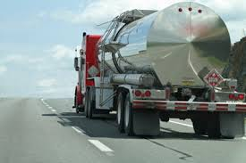
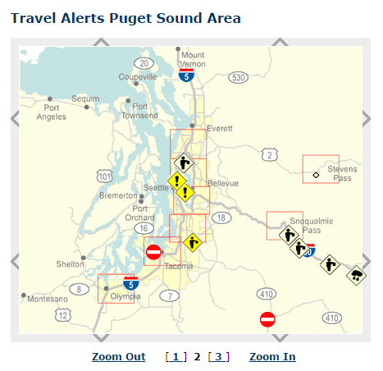
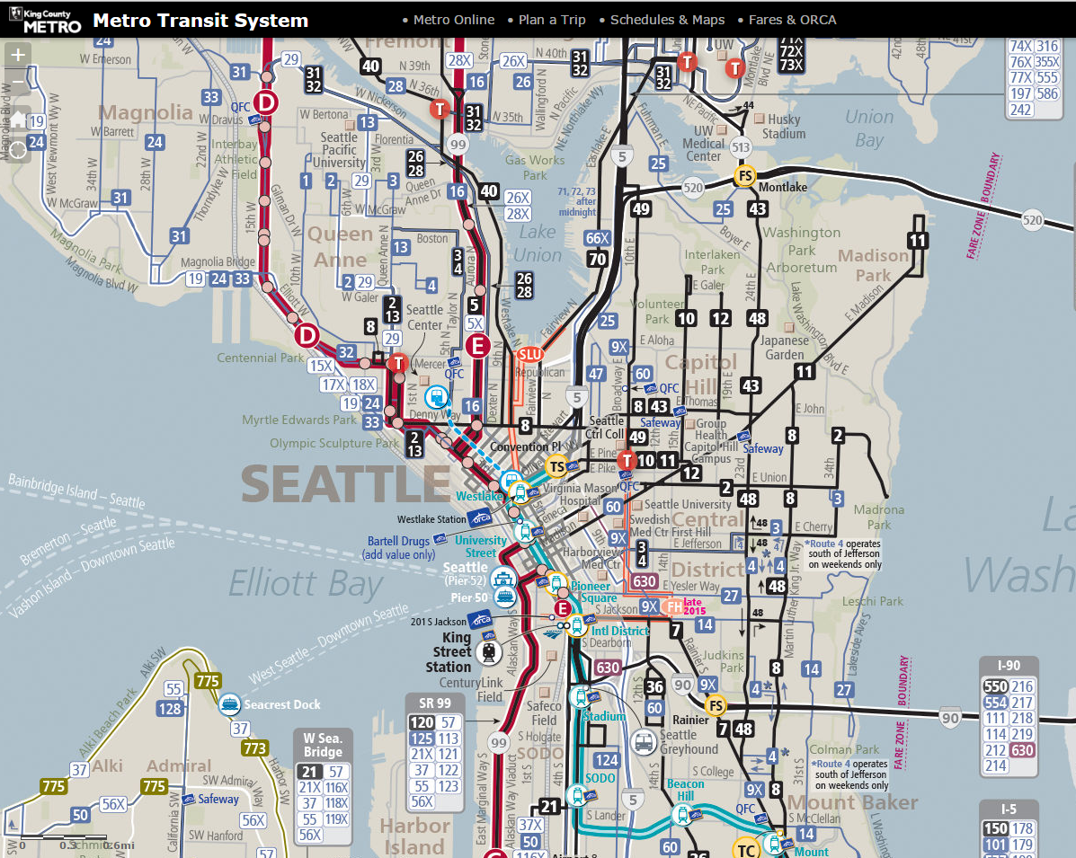
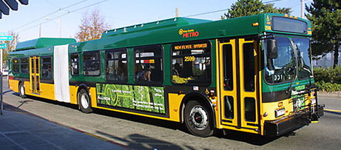


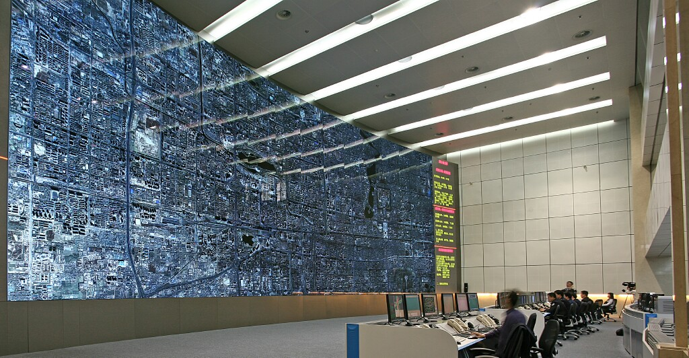

数据对于ITS的成功至关重要
高质量数据
Notes:
In a summary, transportation data is the fundamental for everything:
traffic operation
transit signal priority
Hazard Material vehicle tracking
Traveler information
emergency vehicle route planning, etc.

Slide 31

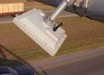
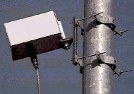
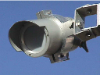
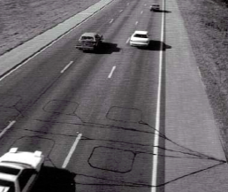


数据来自哪里？
传统来源ources
人工手机
事故记录
施工数据
GIS 数据
数据服务器
Data Archive
交通检测控制器
非传统来源：
移动设备
商业数据公司
自我报告
遥感
传感器
Notes:
Where are the data from? Here shows a list of major data sources.
The majority of data collected by a public agency is available for free. For example, we have been getting a lot of data from WSDOT.
We can also buy data from third parties or commercial companies.
We can always collect data using traffic detectors of our own.
All goes to data servers where practitioners and researchers can access it.

Slide 32
我们什么时候会拥有完整的设备系统？?
ue
未来我们需要去的地方
现在我们需要去的地方
ITS基础架构部署
1990 - 6% 设备化
1997 - 16% 设备化
1999 - 22% 设备化
2025 - 100% 设备化?
ITS部署曲线
我们现在在哪里
Time
Source: Christine Johnson, 2001
Notes:
So… what is the current status of our traffic data collection work?
Ten years ago, a researcher in Maryland (Phil Tarnoff) has estimated the ITS deployment of the transportation system.
Generate a curve like this.
Predicted that we should get a fully instrumented system around the year of 2005.
The problem is …. Right now have we proceeded as predicted?
In terms of data coverage may be we are close.
But if we look at the targets we want to achieve through an ITS system, I would say that we are not deploying a data infrastructure fast enough –
To gives us the ability to respond precisely in a weather event
To allow us to manage – with peak performance precision – an unplanned event
To allow signals to respond to real time surges in traffic
This does not necessarily mean that we don’t have the data, it’s both lack of data/control systems that use the data we have.
20 years ago agencies were data poor. But right now the situation is…
We have data, more and more all the time, and still do not have a proper framework for incorporating that into the decision making process.

Slide 33
全国数据网络
来自数据点
到全国范围的数据网络
政府和社会资本合作：
共担风险 共享利益 共同贡献
Notes:
With the data we have a big improvement could be how we can jump from points of data to an information network.
It is my own belief that the only way we get there is to create a national public private partnership – meaning
Shared risk
Shared benefit
Shared contribution
I don’t think we’ve done anything like it before. It is going to take some hard thinking – something that I believe this institution is uniquely suited to do and thus I challenge the organization to explore and find how we do it together.

Slide 34





例：ATIS的系统架构
ATIS: Advanced Traveler Information System先进的出行者信息系统
Data Warehouse
后端服务器
Data Archive
数据服务器
应用
模型1
应用
模型2
应用
模型n
打包数据
应用服务器
出行者
信息
实时测量
ATIS
On TV
站点
机柜
探测器
用户媒体
Notes:
Let’s take a look at the architecture of an advanced traveler information system.
First detectors, of various types and deployments.
These connect to station cabinet or other local computing and communications portal. Data is sent packed to a database server, which archives it in a data warehouse.
Now the data is just waiting for our application to process and use.
On the front end, we have user media telling people where to drive and how long it will take, and other information. These devices connect directly to an application server, which runs the ATIS interface.
The applications are the logic of the system, and retrieve data from the backend server. The backend server pulls data from the data warehouse and unlike the data warehouse, is fast enough to run in real time.
Why is this so complicated? (next slide)

Slide 35
为什么有中间程序？
交通传感器的直接输出可能不容易理解。
例如，线圈检测器通常只输出一系列可以用二进制形式表示的“高”或“低”电压。
电压
高
低
T_{n}
t_{n1}
t_{n2}
t_{n3}
T_{n+1}
时间
Notes:
A lot happens behind the scenes that is necessary for the system to work.
First we need to look at raw data from loop detectors.
The loop detector is actually a very simple piece of equipment that
only reports whether or not a vehicle is present over the detector at any given time at 60HZ resolution.
To work with data of this kind in any analysis would be very difficult. So, multiple calculation steps convert this into something we can use.

Slide 36
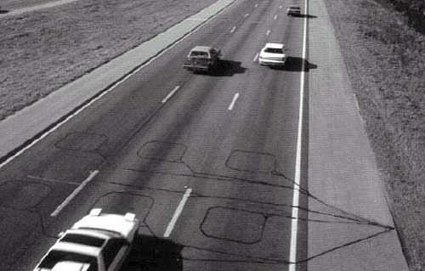
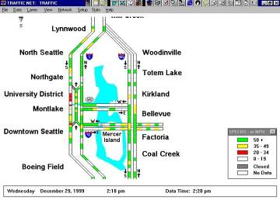
单线圈测量非常有用
原始数据示例:
00001010
00001010
00001000
00001000
00001100
00000100
处理后线圈数据：
时间 流量 占有率 速度00:00:00 2 1.36% 68.2
00:00:20 1 0.06% 70.2
00:00:40 3 1.90% 67.4
许多在线ATIS都是基于单线圈数据的！
Notes:
You seen here on the top left the binary output of the loop detectors, or just zeros and ones.
This is converted in the cabinet to aggregated 20 second volume and occupancy data, as well as speed in the case of dual loop detectors.
Now this is something we can actually use, but to make it more informative to travelers, we need to combine with the roadway network data create visualizations, and quality check (important step!)
Most of the early ATIS systems created by DOTs were based on loop data, but the ones we use now (i.e. BING or Google maps) are based on probe vehicle location data, that is, data provided by other users of the information system.
As deployment of more advanced detection technologies increases, single loop data may become less important, but the need to process raw data into a useable form will not.

Slide 37
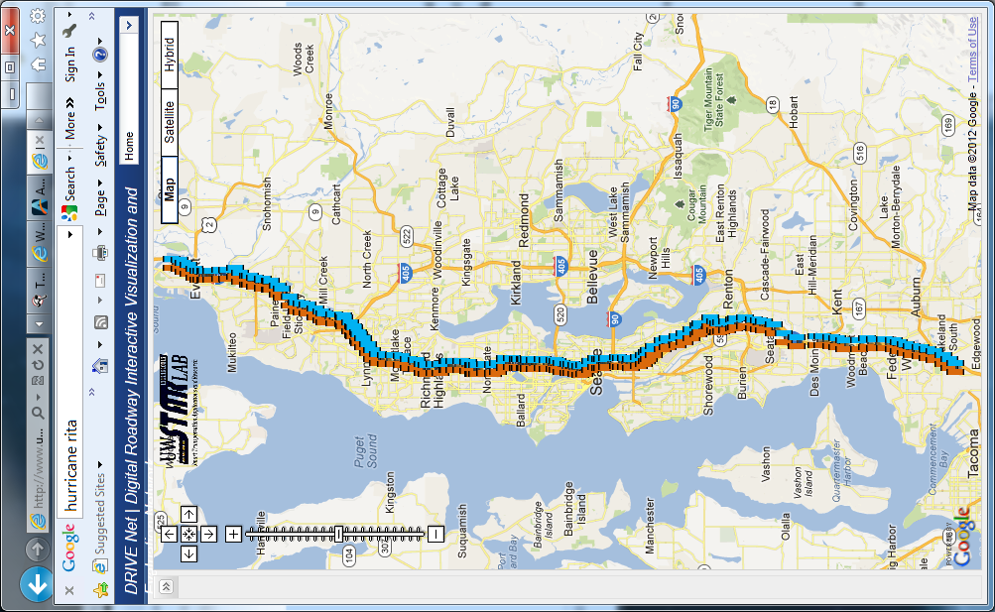
大西雅图地区的I-5线圈检测器
仅在华盛顿西北部地区就有7000多个环形线圈探测器
N
(I developed when I completed my PhD degree at University of Washington)
Notes:
Now, there are thousands of loop detectors on the highways of Washington state as in other states, over 7000 in WSDOTs northwest region alone.
Note that this is the case in US. It is clear that many newer systems do not rely on loop detectors to the extent that we do here.
However, it really does not matter what the technology is, because the skills, computing, and storage requirements will only increase with more advanced detection technology.

Slide 38
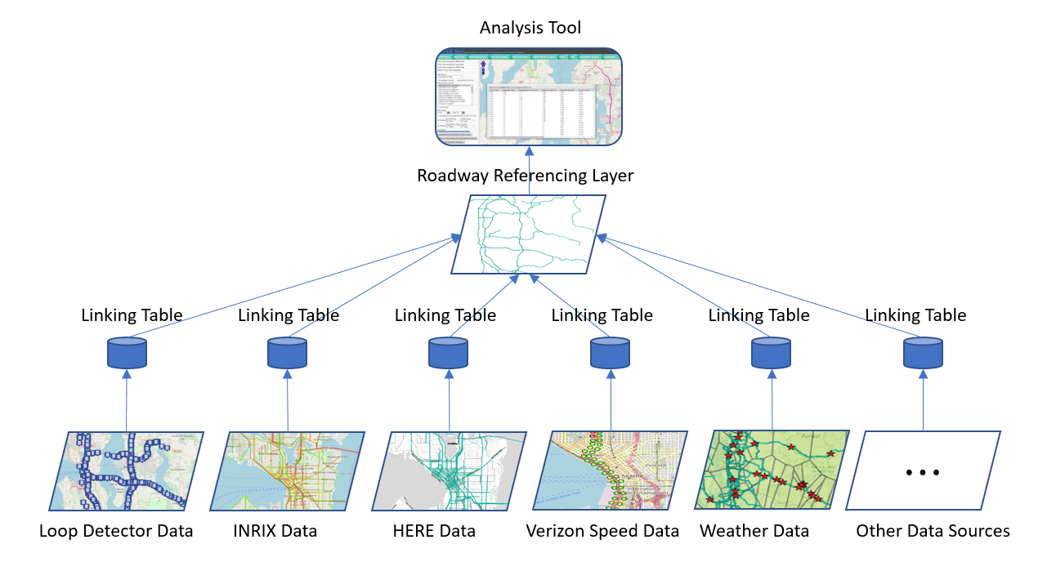






结合其他数据源
+
Notes:
You will learn SQL Server, R and PostGIS in this course.

Slide 39
如何处理这些数据？
如果每20秒完成一次线圈检测，并且每条记录需要20个字节来存储，那么8000个单线圈检测器每天需要
24*3600/20*20*8000=660 MB的存储空间！
注意这只是高速公路上线圈探测器的数据。我们还有浮动测数据，事故数据，货运数据，视频数据，…，要处理！
Notes:
Here are some more numbers. If you do a little bit calculation you will find 8000 WSDOT loop detectors can generate 660MB of data per day.
This is not a surprisingly large size but this can gradually take a large space.
Keep in mind that this does not include all of the other data the state is interested.
In our previous research projects, we need to integrate data from loop detectors, probe vehicle data, travel time data, throughput data and roadway network data.
Loop detector data is one of the smallest data type (binary).

Slide 40
其他数据来源呢？
例如： INRIX（实时交通数据公司）
1.75亿台设备
400万英里的道路
40个国家
每天有 TB 级的数据
实时出行者信息、分析和决策支持
Source: https://Inrix.com
Notes:
Here is an example of the incoming challenges to managing transportation data.
The company INRIX that I mentioned earlier now collects data from over 175 million devices, and covers 4 million miles of roads in 40 countries.
Now we are talking about multiple terabytes per day.
And that amount will continue to grow as more devices and device capabilities are added.
Governments and data companies do not just collect and manage data, they must also provide real-time information and historical analytics based on this data.
Thus, in developing a system to manage the data, we have the potentially conflicting objectives of storage and query efficiency.

Slide 41
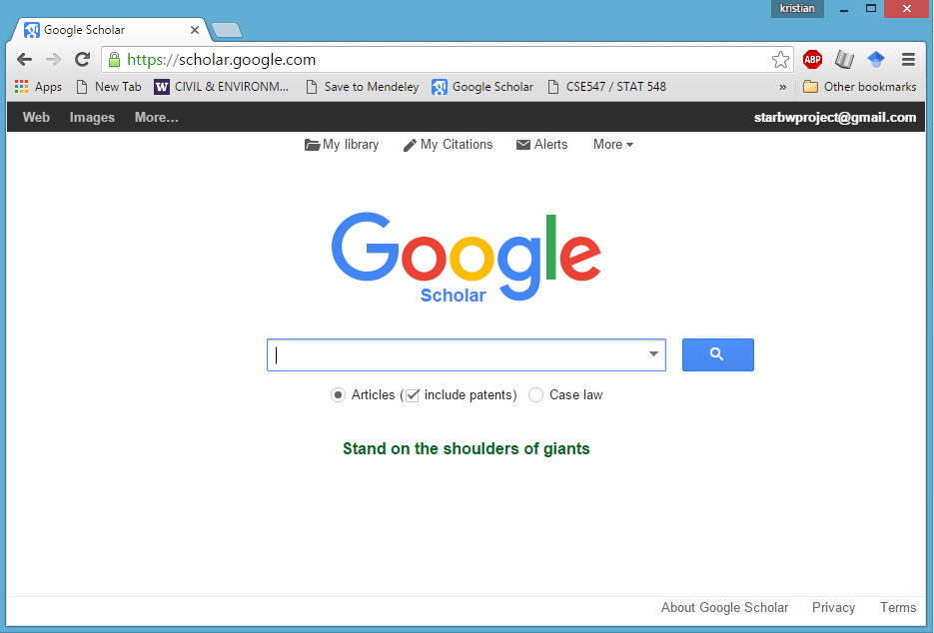
良好管理数据的好处？
数据处理和查询的效率可能大不相同
Notes:
Consider that data management has multiple objectives.
store the information efficiently
find what we want as quickly as possible.
perform operations and analysis
A data structure optimized for storage efficiency is not well suited to these other uses.
Consider doing a literature search using paper journals vs online query.
There is no problem storing all of the paper journals in boxes and shelves, but by archiving the articles in a searchable online platform, the information is much easier to access and use.
This is why we got an F in the traffic signal report card for data management, not because we didn’t have the ability to store the data, but because we did not invest the time and money to make the data we are collecting well-structured, quality controlled, and usable for decision support.

Slide 42
良好管理数据的好处？
The Ballad of DRIVE Net:
WSDOT has massive data resources, but struggles to apply much of it in performance reporting and decision support
Organization, data integration, spatial conflation, data sharing, etc. are disjointed and often done “as needed” for specific tasks
To WSDOT, DRIVE Net represents a an automated data management and integration platform
管理良好的数据：简化维护和分析
管理不善的数据：通常 使其可用的工作量 超过了 使用它的好处
Notes:
One last point. I mentioned DRIVE Net before.
We advertise it as an advanced analytics platform, capable of doing things that are not often done in conventional transportation engineering.
When WSDOT started to understand it, they were less interested in our big ideas and more interested in the data management and integration tools we were developing to support it.
They have tons of data, but they so far have been unable (unwilling?) to make it completely useable for decision support.
The data management strength actually helped us to gain continuous funding that support the development of the platform until today.

Slide 43
Extracting Useful Information
Transportation Data Analysis
Data analytical methods for transportation data analysis
Transportation Data Visualization
Proper data visualization tools to generate charts, graphs, maps, etc.

Slide 44
数据可视化
数据可视化
信息和数据的图形表示
常见类型：
图表，表格，图形，地图，信息图表，仪表板
数据可视化的益处
Pattern discovery
Trends, outliers, patterns in data
Efficient to see the big picture
Support the decision-making process

Slide 45
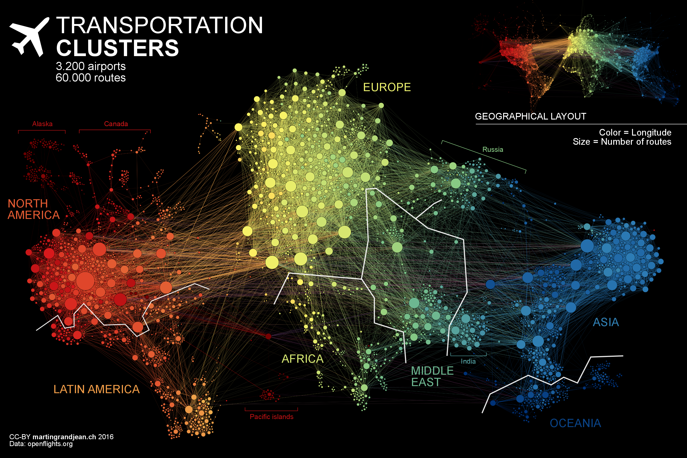
数据可视化的重要性
https://www.visualcapitalist.com/air-traffic-network-map/

Slide 46
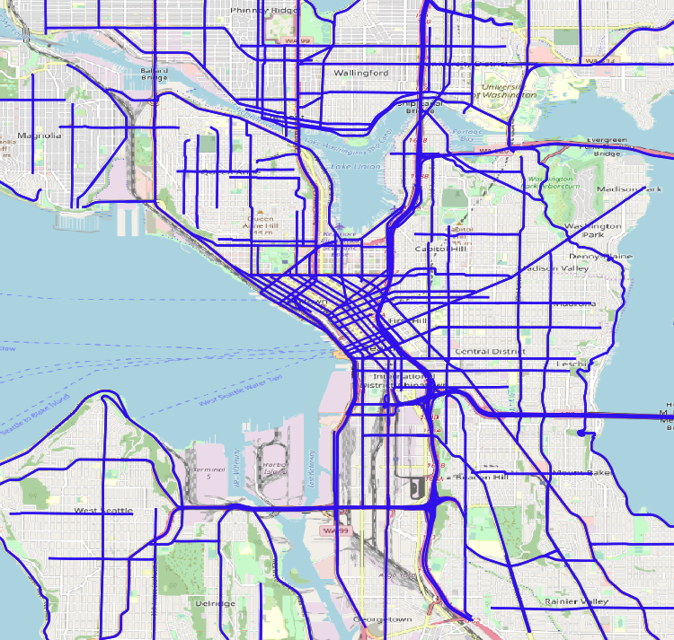
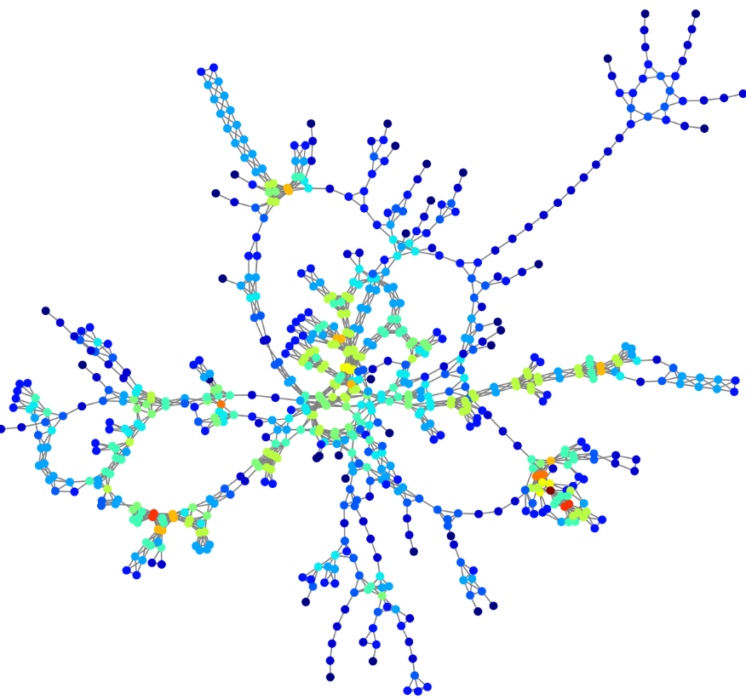
数据可视化的重要性

Slide 47
这是我们开设交通大数据分析课程的原因
可用于交通管理和决策的数据源的数量和种类正在迅速增加
有效地存储和检索交通数据至关重要
恰当地对处理后的数据和分析结果进行可视化，有益于决策
Notes:
So this basically concludes the extended advertisement of this class.
Now more data literacy is more important than ever in human history is data literacy important.
We want decisions to be based on the best possible information for maximum impact.
We have more data available than ever before, and it is still rapidly increasing.
This class will provide the knowledge of some powerful data analytic tools and I hope this will make your lives easier.

Slide 48
本课程包括哪些内容？
Notes:
Let’s talk about what we are going to cover in this class.

Slide 49
数据管理概念和工具
关系数据库设计与管理
结构化查询语言（SQL）—专用数据库编程语言
Microsoft SQL Server —企业数据库管理系统
Notes:
We are definitely going to spend substantial time working with relational databases, including designing and implementing databases and querying data.
SQL is the language for working with such data management systems, and we will spend time learning this language.
This is a very high level language, and I think you will find it both intuitive and even elegant.
Though there are a number of software tools for doing this, we will work primarily with Microsoft SQL Server.
This is an enterprise grade data management system, and it is very powerful and full featured.

Slide 50
数据处理 & 分析
结构化 vs 非结构化数据
数据预处理和质量把控
R—用于统计分析的软件包
数据可视化
Notes:
We are going to go through a number of issues related to storing, managing, and querying data, including data structure and quality control.
We will also spend some time doing analysis by combining R and SQL, and turning the results of our analysis into something interpretable.
Analysis is not the primary focus of this class, but it is really important to understand how programing tools and databases work together and how to pass data between the two.
We will also talk about data sharing, web applications, and web services. The depth that we go into is constrained by the time we have available, but we will at least introduce topics such as XML and web services, and we will have project related to sharing data online.

Slide 51
交通数据分析基础
线圈检测器数据
事故分析
人工智能
交通中的新兴数据源
Notes:
This class is primarily related to tools, and because of this I encourage everyone to bring their laptops to class if possible.
Keep in mind that this is a transportation class, and so most of the examples we will use are related to the transportation domain such as loop detectors, accident analysis, and data sources relevant to the study of transportation.
It does not mater if transportation is not your primary focus, as most of the topics we will cover are pretty general in nature.

Slide 52
本课程是如何组织的？

Slide 53
课程时间表
Week | Day | 主题 | Notes | Homework
2 | Fri | 课程简介及概述
3 | Fri | 数据库介绍 | MOOC
4 | Fri | E/R图 | MOOC | 作业#1 发布
5 | Fri | 关系数据模型 | MOOC
6 | Fri | 结构化查询语言 I | MOOC,练习1
7 | Fri | 结构化查询语言 II | MOOC | 作业#2 发布
8 | Fri | R的介绍 I | MOOC
9 | Fri | R的介绍 II | MOOC, 练习 2
10 | Fri | 数据可视化 |  | 项目发布
11 | Fri | 交通中的统计学 I |  | 作业#3 发布
12 | Fri | 交通中的统计学 II | MOOC
13 | Fri | 安全和通行能力分析 I |  | 作业#4 发布
14 | Fri | 安全和通行能力分析 II | 练习 3
15 | Fri | 交通中的人工智能 | MOOC, 练习 4
16 | Fri | 嘉宾讲座
17 | Fri | 小组展示

Slide 54
作业和项目
书面作业：作业布置后一周提交
作业 #1：E/R图
作业 #2： SQL 练习
作业 #3： 统计分析
作业 #4：安全和通行能力模型
线上提交
一次小组项目
项目：数据库设计和可视化
Notes:
We will have 4 assignments and 2 group projects.
Talk about cheating:
I am sure this is all old news to you, but although I encourage you to discuss and interact when completing assignments, each assignment must be completed individually. Also, group members working on a project will be asked to complete an evaluation of their fellow group members. This is an attempt to avoid the ever present issue of one or two people being stuck with all the work.

Slide 55
规定
不接受任何延迟的作业/项目。
如果出现特殊情况，则需要在作业到期日之前说明。
期待大家参与课程，但不强制。
成绩构成：
期末考试： 60%
作业：20%
项目：20%

